Slide 1
Internal Project
Web Report
Round 2 Comments
24 Oct 2016

Slide 2
Introduction
This revision is to create a web report by reducing the time consumed by the user and they can concentrate more on technical details.
The comments are made on the high level and detailed.

Slide 3
Process Layout (Existing)
Improvements
Convert Tables into .csv file
References and navigation should be automated
HTML
(Tables,
Reference, Navigation)
Report Program
Report
Charts in .csv file format,
Figures in folder

Slide 4
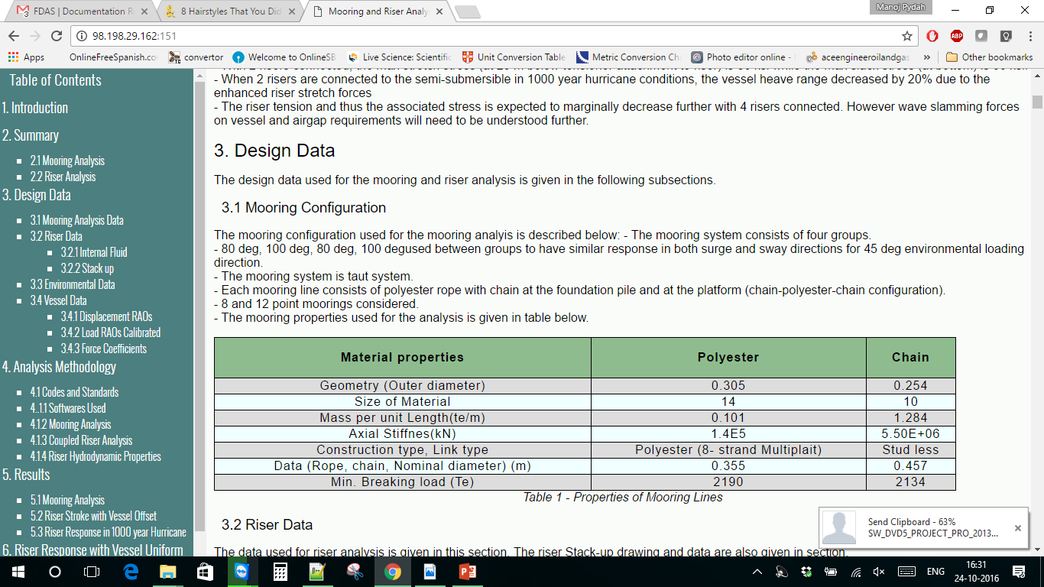
Tables
The tables format and style is good. Don’t change it.
Tables should be updated from .csv not from editing the code.
The width of the tables is high, decrease the width.

Slide 5
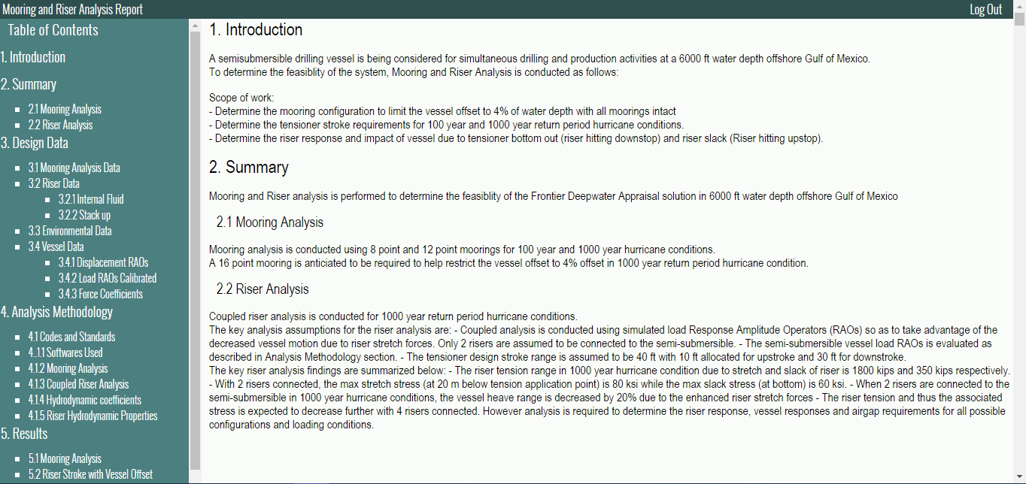
Introduction and Summary
Add print button to the web report.
The print should be automatically adjusted to A4 size sheet
Print

Slide 6
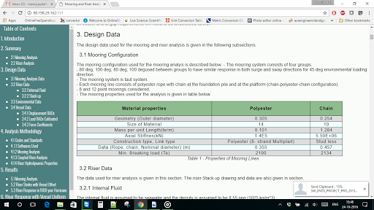
Screen Friendly
Adding boot strap to the website
Formatting all the web report to one “Theme font” and “size” except for headings.

Slide 7
Functionality
Improving UI & functionality where ever it is possible for smooth transaction and good readability.

Slide 8
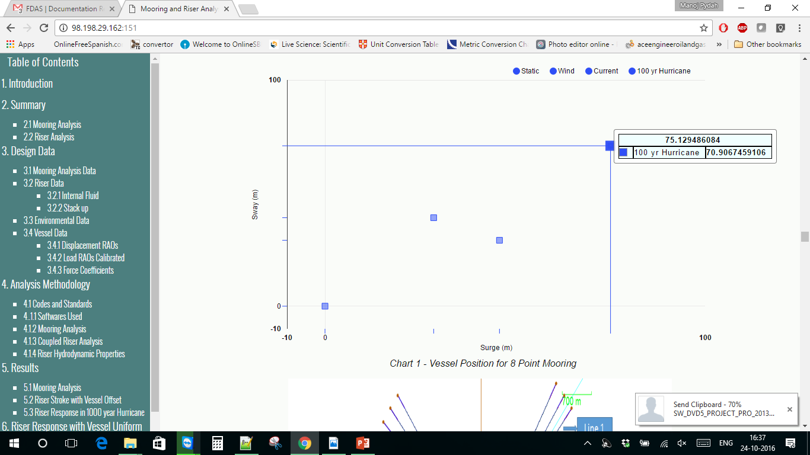
Charts
The charts are good. Need to improve the following
Need to reduce the rounding off to one decimal value (or) 1% error . Automatically also change display format (refer to Ace programming docs?)

Slide 9
Modular Design
Section Files as modular design.
Each section file will have the following
Text
Table .csv
Chart (.csv) chart csv
Reference will be given by .csv file name.

Slide 10
Automation
The sections numbers should be automatic.
Need to cross references the web report.

Slide 11
THANK YOU
For the opportunity to serve!

Slide 12
Document Revision History
02 | Round 2 comments. Round 1 comments in PRE-0008-01 | 24 Oct 2016 |  | GSY | VA
01 | Round 2 comments. Round 1 comments in PRE-0006-01 | 12 Sept 2016 |  | GSY | VA
Rev | Description | Date |  | Author | Checked | Approved
Document No: |  |  | Client Ref:
0119-PRE-0008-01 |  |  | n/a

